Slide 1
Periodic Metasurface Inverse Design via Deep Learning
Shengnan

Slide 2
Update from last week
Accre Training Failed
New shape generating mechanism
Generate and fix spectrum
Neural Network for coordinate build
New Idea about neural network – Self-correcting neural network

Slide 3
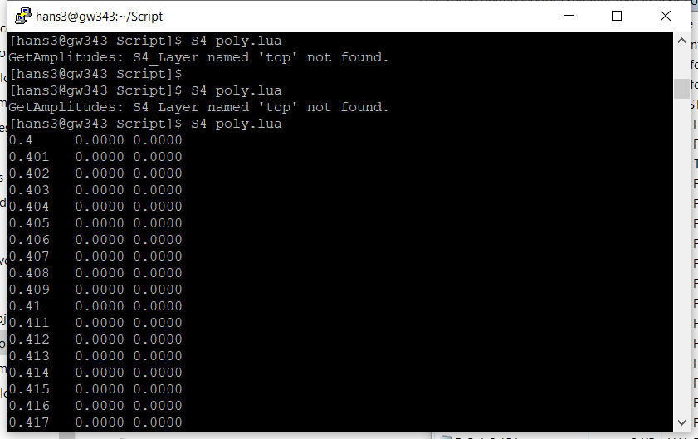
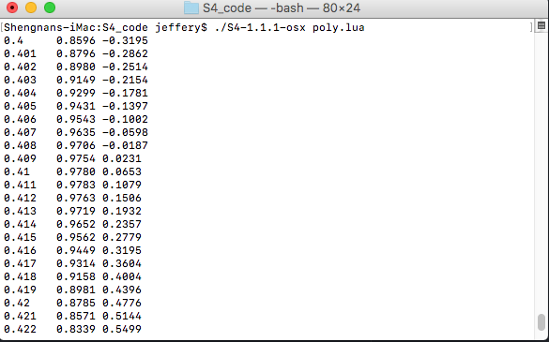
Accre Training Failed
The binary package and the version on cluster is different
S4 developer not responds
Notes:
I have been able to reproduce your results. At the same time I have also successfully executed some of the example scripts provided in the GitHub repository. This confirms that the installed S4 is actually working. I have then inspected the date of creation of the S4 binary for Mac OS X and it is dated Jun 15 2014. Since then the code changed in the repository and the build available on the cluster is done by using the sources from the latest commit. At this point I am inclined to believe that, given the age of the binary you are using, some of the changed made by the developers are actually affecting your results on the cluster. The only course of action at this point is to contact the developers directly and notify them of a potential bug. Unfortunately they do not seem to be particularly responsive on GitHub, so I recommend you to attempt to reach them via email. Please let me know if I can be of any additional support.

Slide 4
New shape generating mechanism
Eliminating points on the same line
Less unnecessary coordinate information
Decrease diffraction to 70 (it seems 100 – 50 produce enough info)
Faster training speed
Less messy spectrum!
Previously ~20% messy spectrum
Now ~10% messy spectrum

Slide 5
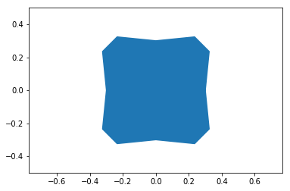
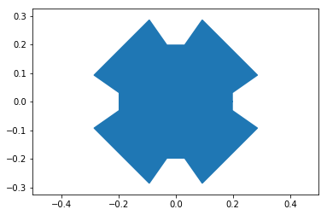
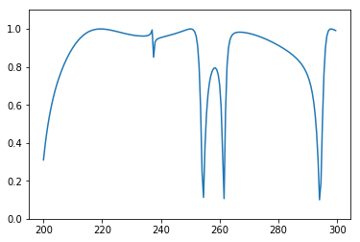
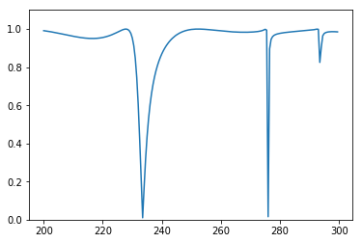
Some new spectrums and shape

Slide 6
Generate and fix spectrum
Go to C:\Users\jeffe\Desktop\Summer_research\S4_code\Batch_info.rtf

Slide 7
Neural Network for coordinate build
C:\Users\jeffe\Desktop\Summer_research\cylinder\Cylinder_to_coordinate.ipynb

Slide 8
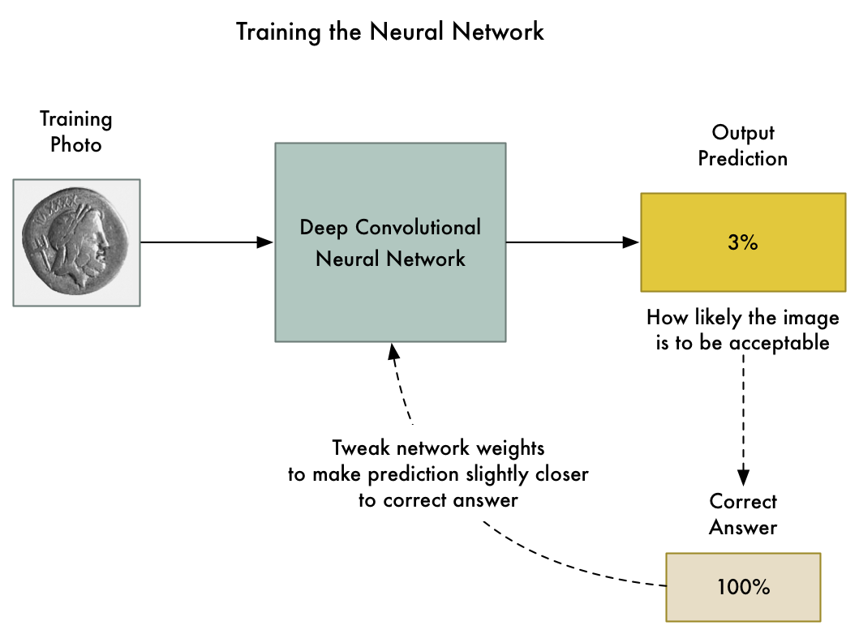
Self-correcting Neural Network
A neural network that can correct itself

Slide 9
Intuition
Use the predicted shape as an input shape to improve the dataset, which may improve the performance
Difficulty:
A better way to measure how close we are to the correct answers.
Integrate neural network with traditional simulator (RCWA, Meep, or CST)

Slide 10
Thank you

